Slide 1
Predicting Customer Buying Behaviour
Predicting customer buying behaviour
Predicting customer buying behaviour
Presented by: IDRIS ADEBISI
23/12/2022

Slide 2
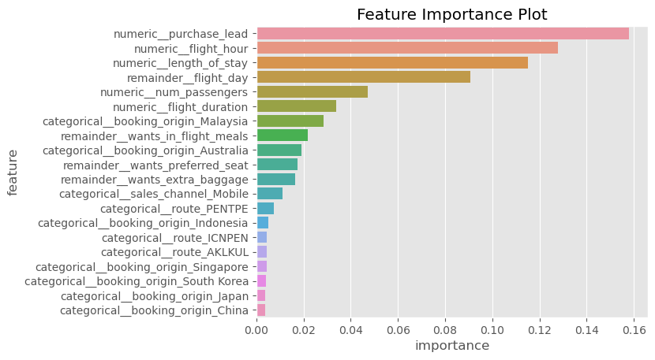
ANALYSIS
Best Performing Model was the random forest model and the metrics used for the model evaluation are listed below:
Precision: 0.87
Recall: 0.98
Accuracy: 0.85
Balanced Accuracy: 0.56
The reason why balanced accuracy was used as part of the metrics in determining the best model was because of the presence of class imbalance in the dataset. one class was having more than 85% data points.
This kind of dataset will result in a model that is skewed, this means that the model will perform well in predicting the majority class.
Plot showing the features that are important in predicting customer behaviour in descending order.

